Slide 1
Meeting 16
Dinsdag 26/06/2018

Slide 2
Agenda
Comparison LES and Park
Optimization method
LES superposition
Practical questions

Slide 3
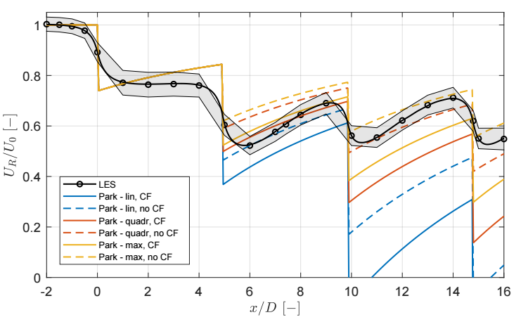
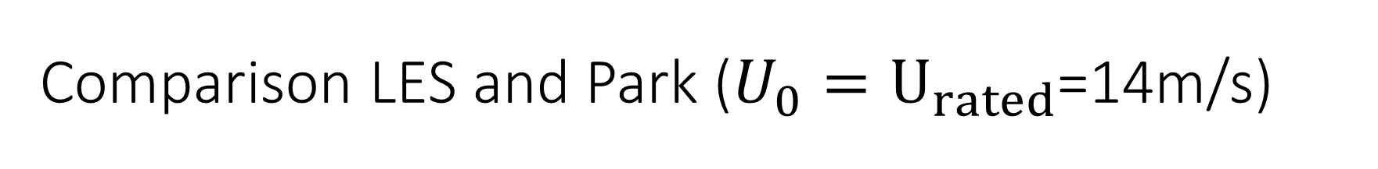
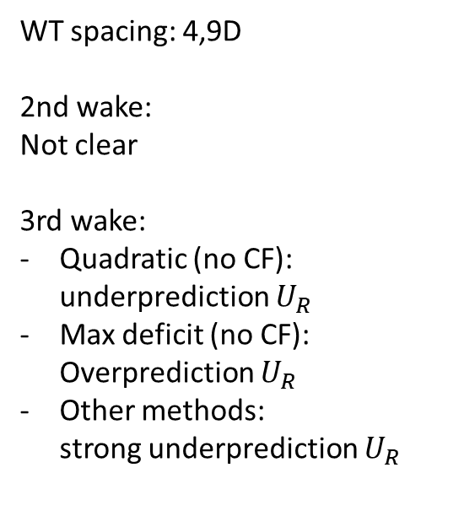
Comparison LES and Park ($U_{0}{=U}_{rated}$=14m/s)
WT spacing: 4,9D
2nd wake:
Not clear
3rd wake:
Quadratic (no CF): underprediction $U_{R}$
Max deficit (no CF): Overprediction $U_{R}$
Other methods: strong underprediction $U_{R}$

Slide 4
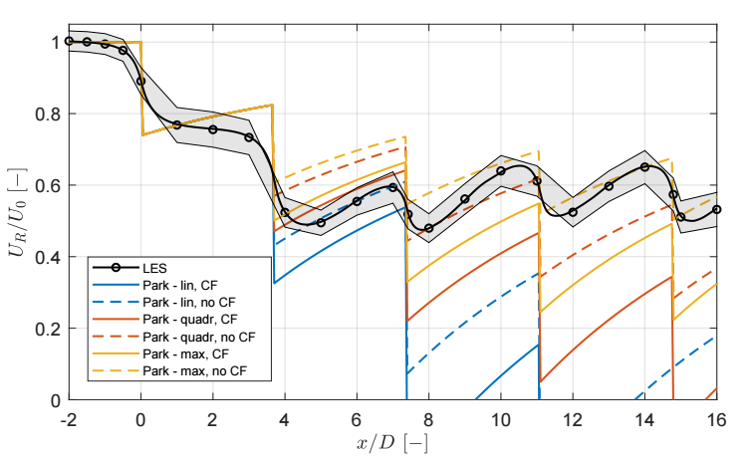
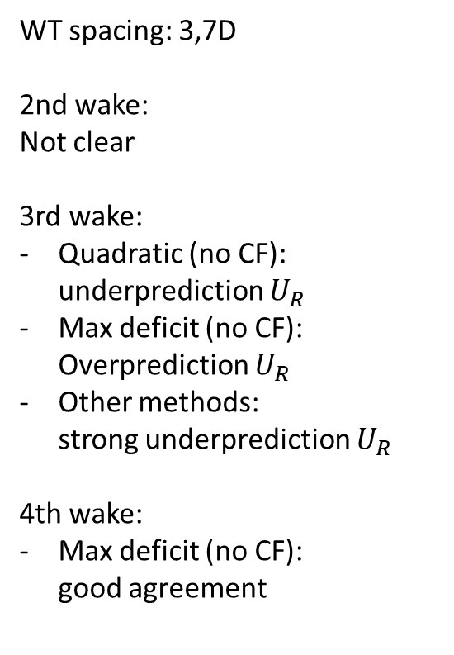
Comparison LES and Park ($U_{0}{=U}_{rated}$=14m/s)
WT spacing: 3,7D
2nd wake:
Not clear
3rd wake:
Quadratic (no CF): underprediction $U_{R}$
Max deficit (no CF): Overprediction $U_{R}$
Other methods: strong underprediction $U_{R}$
4th wake:
Max deficit (no CF): good agreement

Slide 5
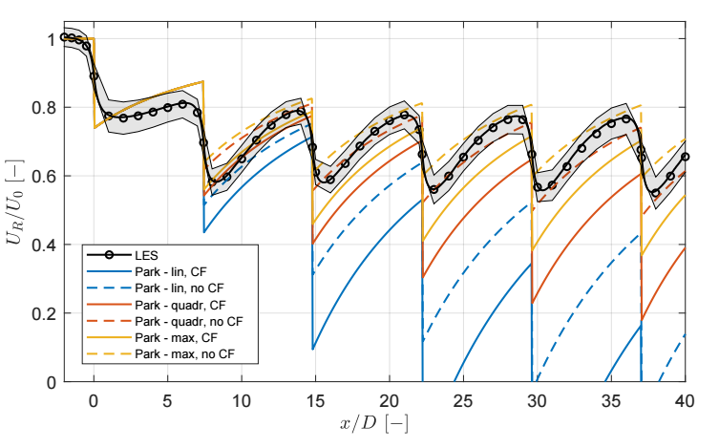
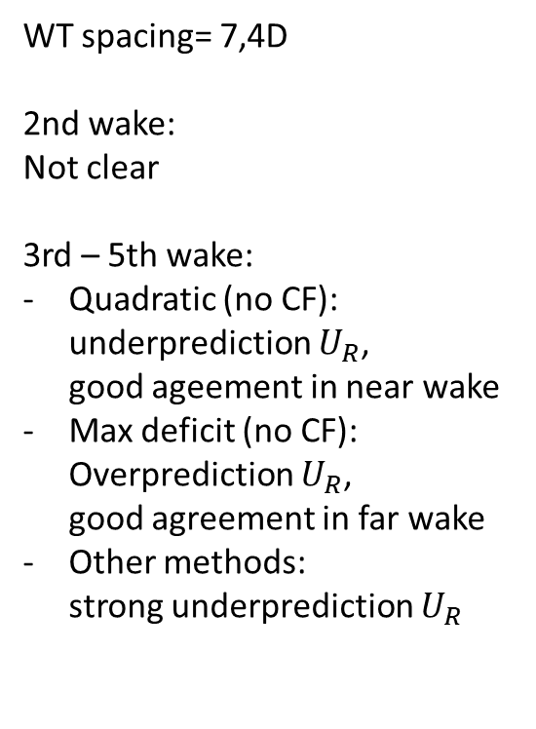
Comparison LES and Park ($U_{0}{=U}_{rated}$=14m/s)
WT spacing= 7,4D
2nd wake:
Not clear
3rd – 5th wake:
Quadratic (no CF): underprediction $U_{R}$, good ageement in near wake
Max deficit (no CF): Overprediction $U_{R}$, good agreement in far wake
Other methods: strong underprediction $U_{R}$

Slide 6
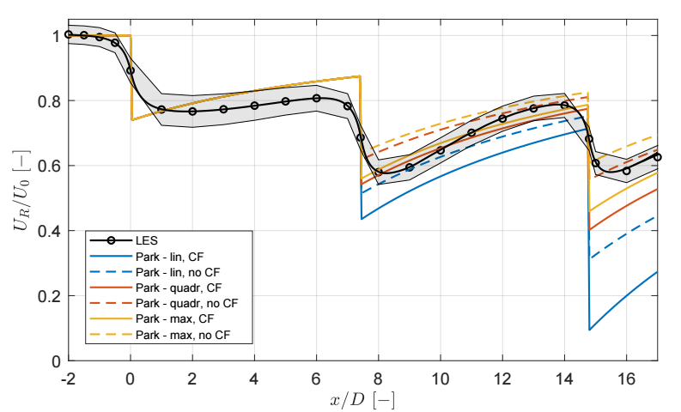

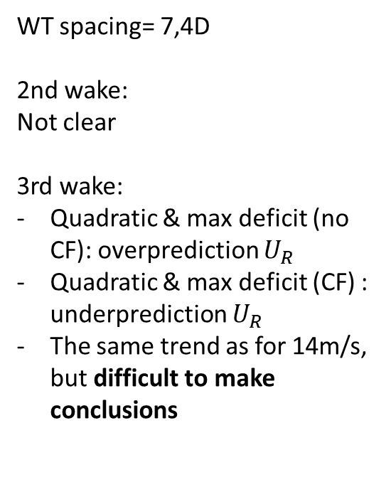
Comparison LES and Park ($U_{0}$=11,2m/s)
WT spacing= 7,4D
2nd wake:
Not clear
3rd wake:
Quadratic & max deficit (no CF): overprediction $U_{R}$
Quadratic & max deficit (CF) : underprediction $U_{R}$
The same trend as for 14m/s, but difficult to make conclusions

Slide 7
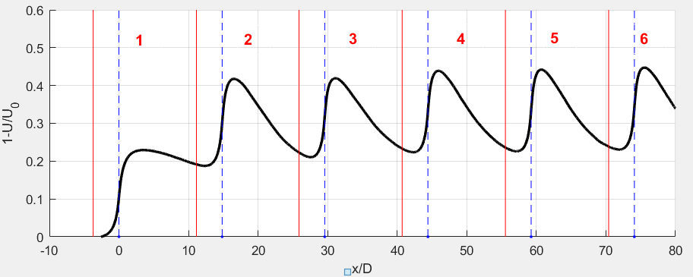

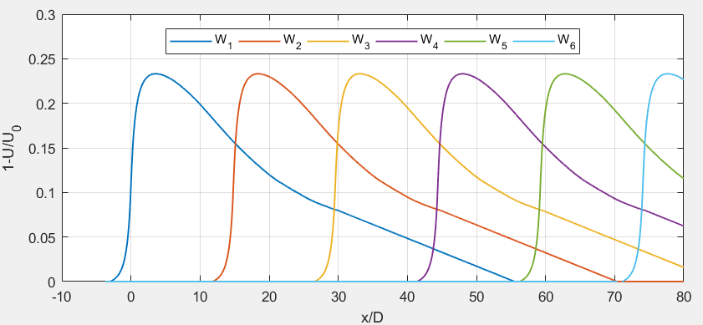
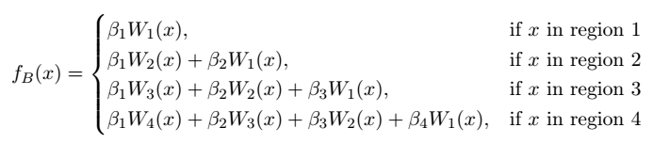
Optimization methods
Method A
Method B
x/R

Slide 8
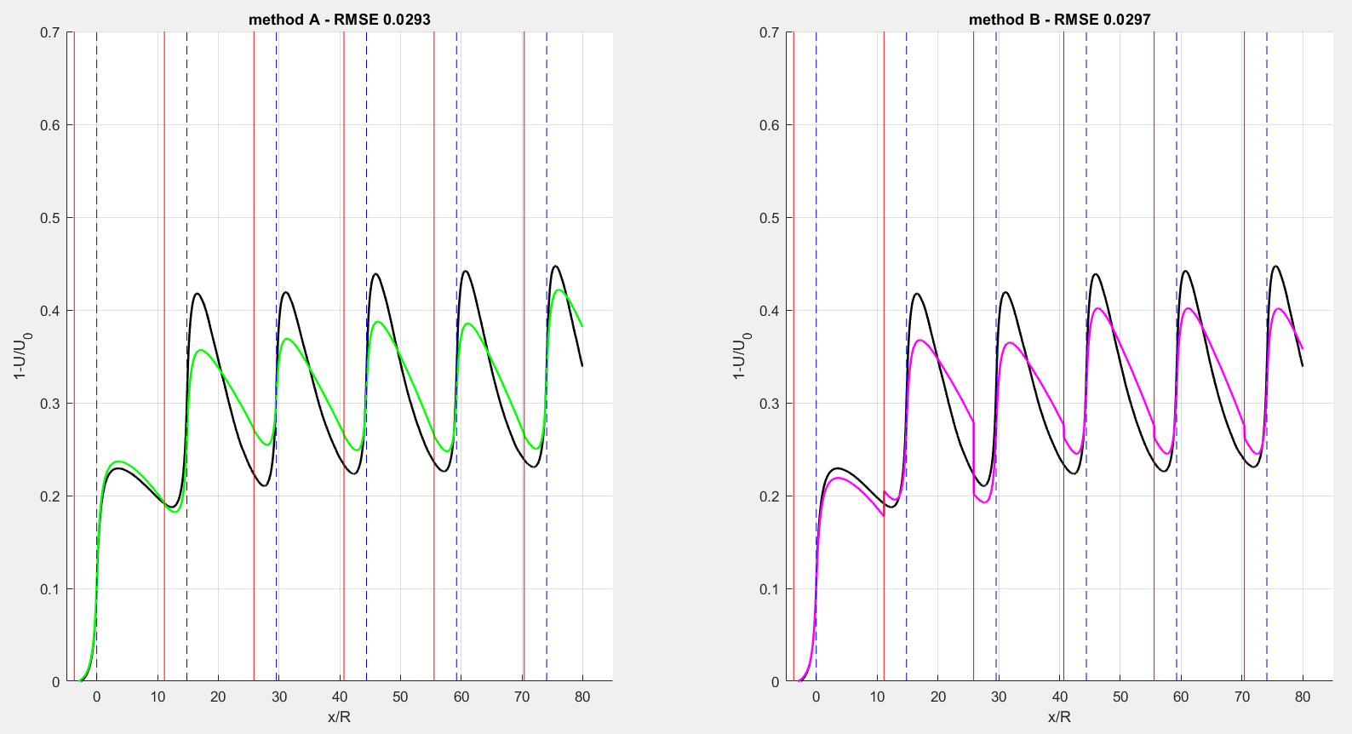
Optimization methods
x/R

Slide 9
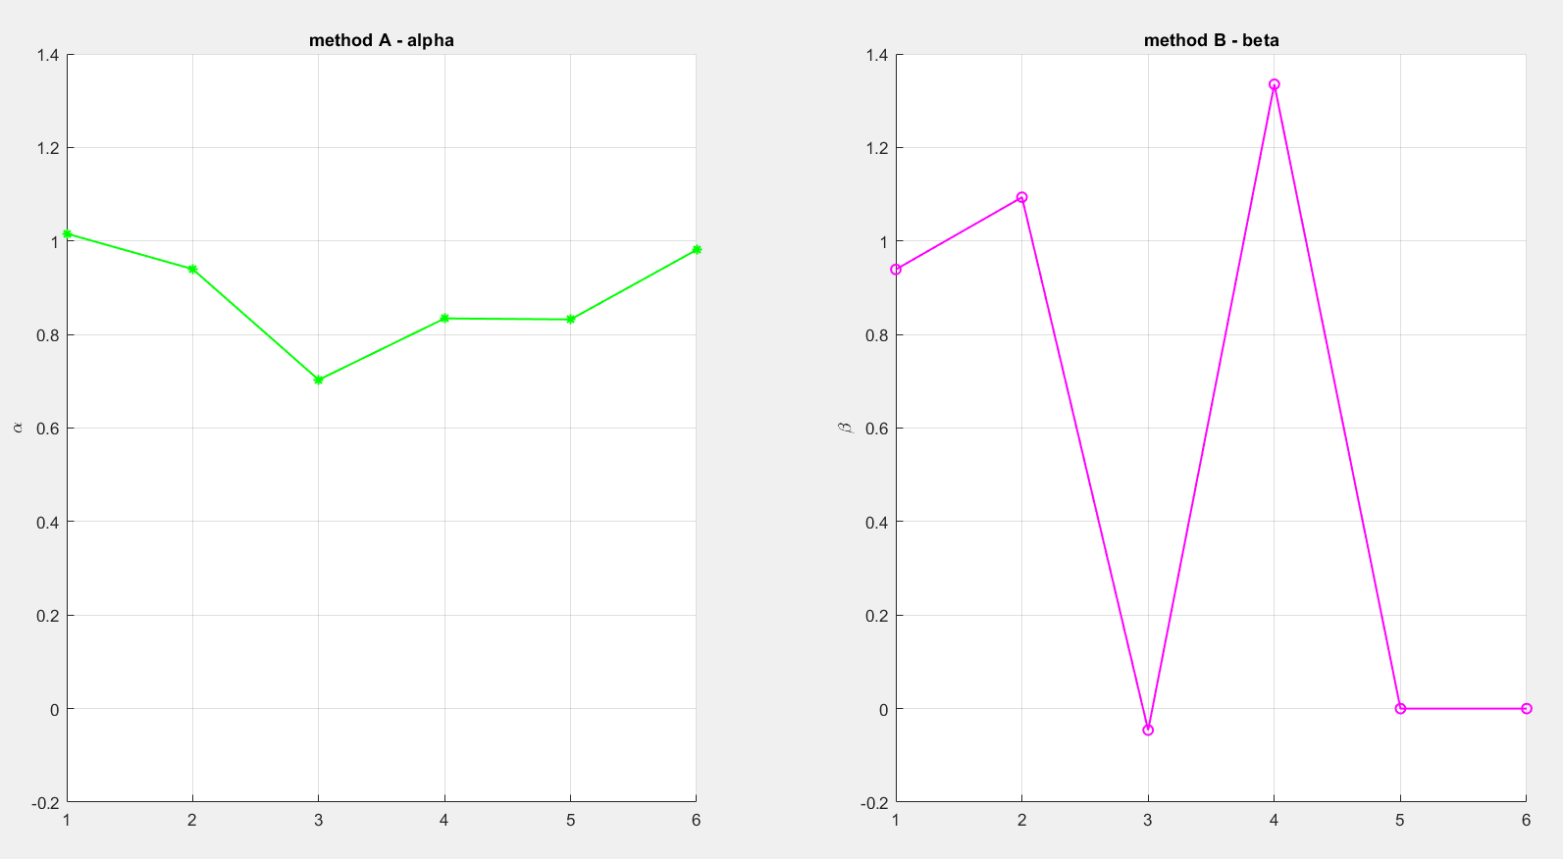
Optimization methods

Slide 10
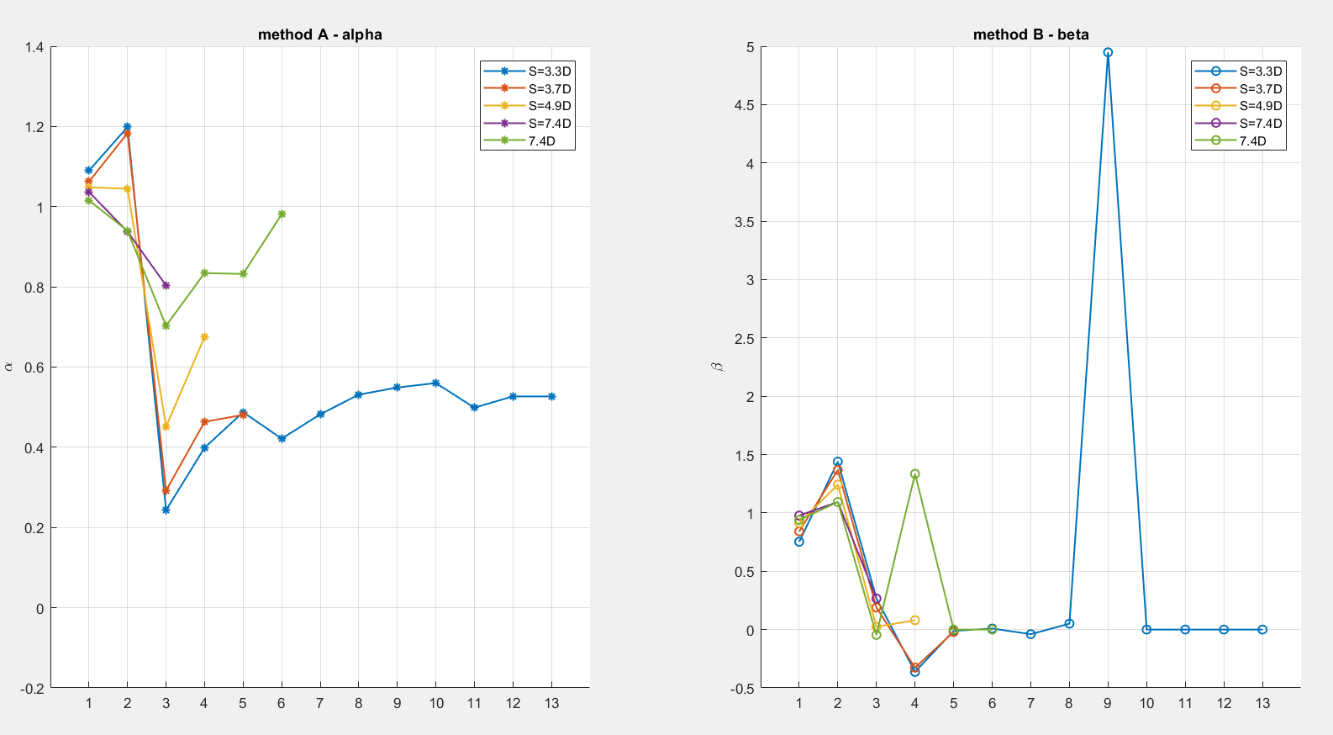
Optimization methods – different spacing

Slide 11
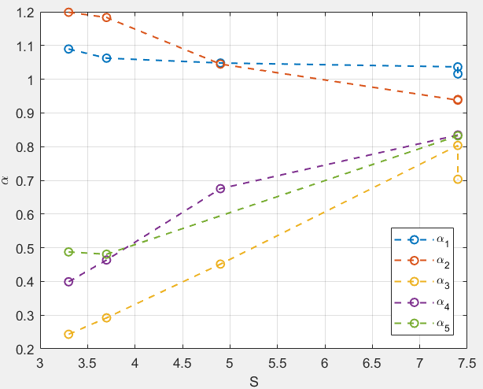
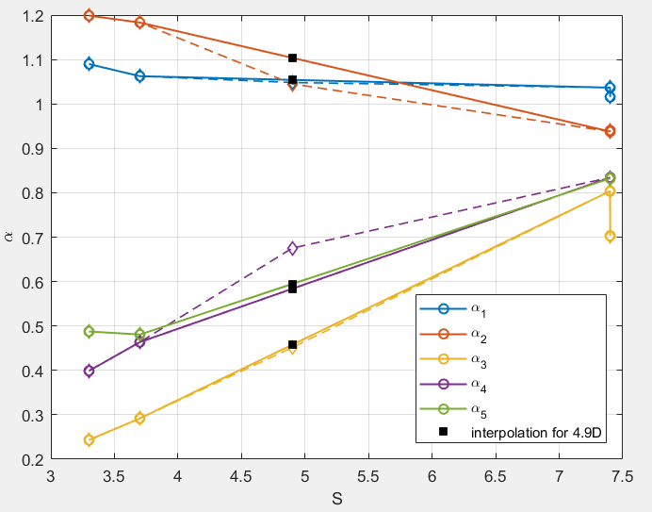
Optimization methods – different spacing
Method A
What if only coefficients of S=3.3D, S=3.7D and S7.D available? Can I predict the alpha coefficients for S=4,9D?

Slide 12
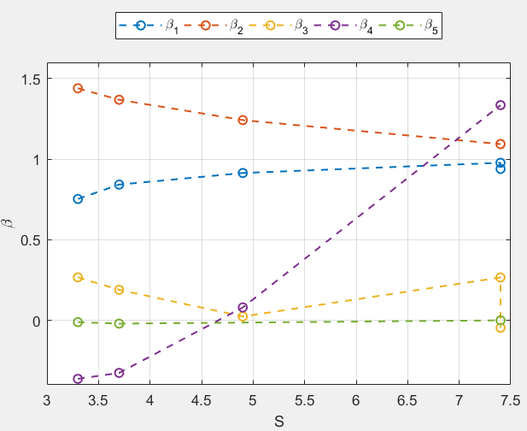
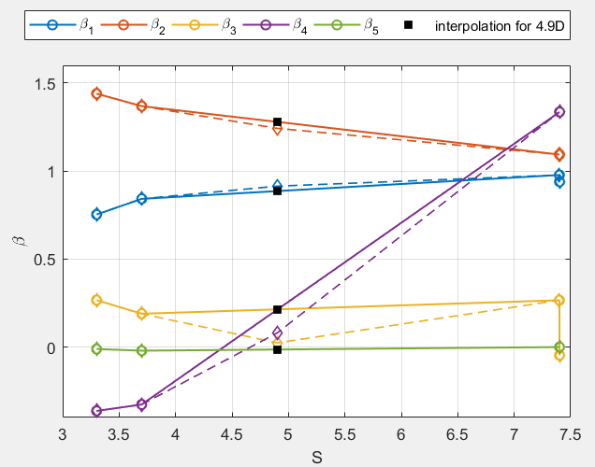
Optimization methods – different spacing
Method B
What if only coefficients of S=3.3D, S=3.7D and S7.D available? Can I predict the beta coefficients for S=4,9D?

Slide 13
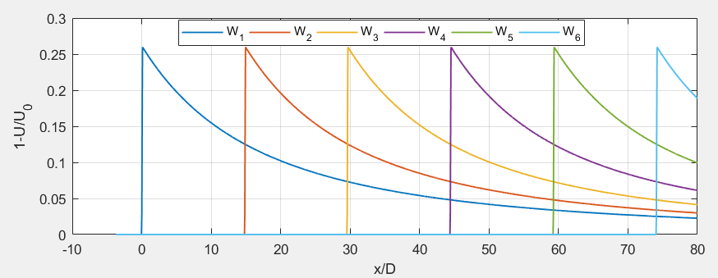
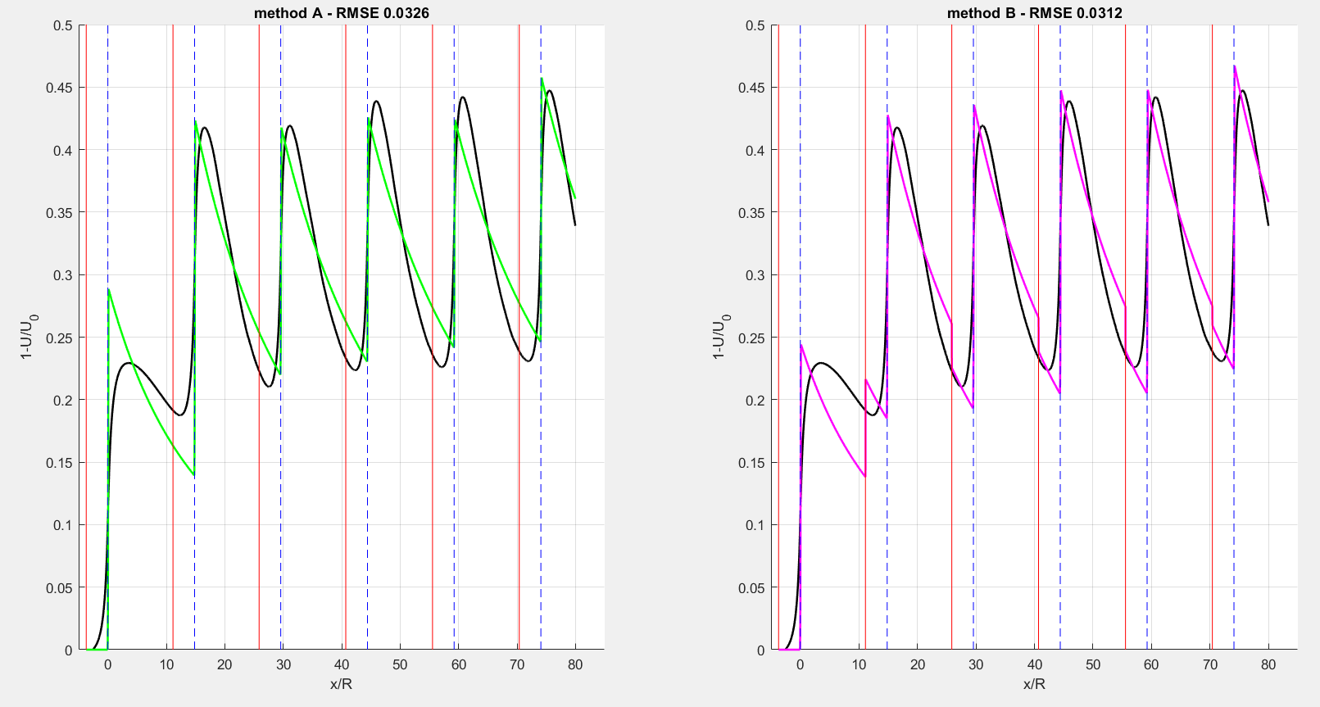
Optimization methods – Park wake

Slide 14
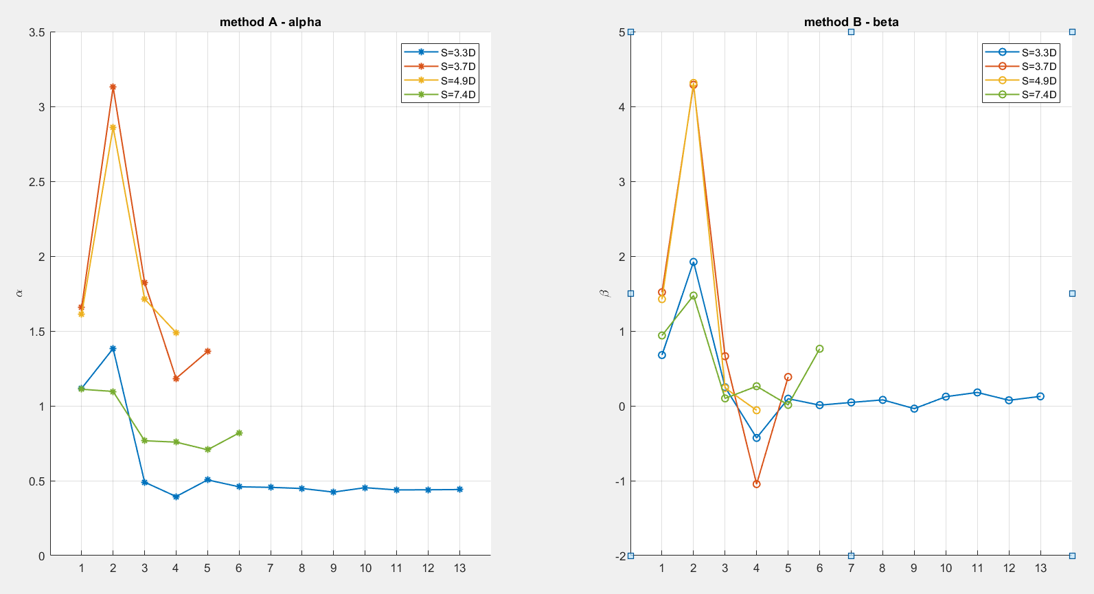
Optimization methods – Park wake

Slide 15
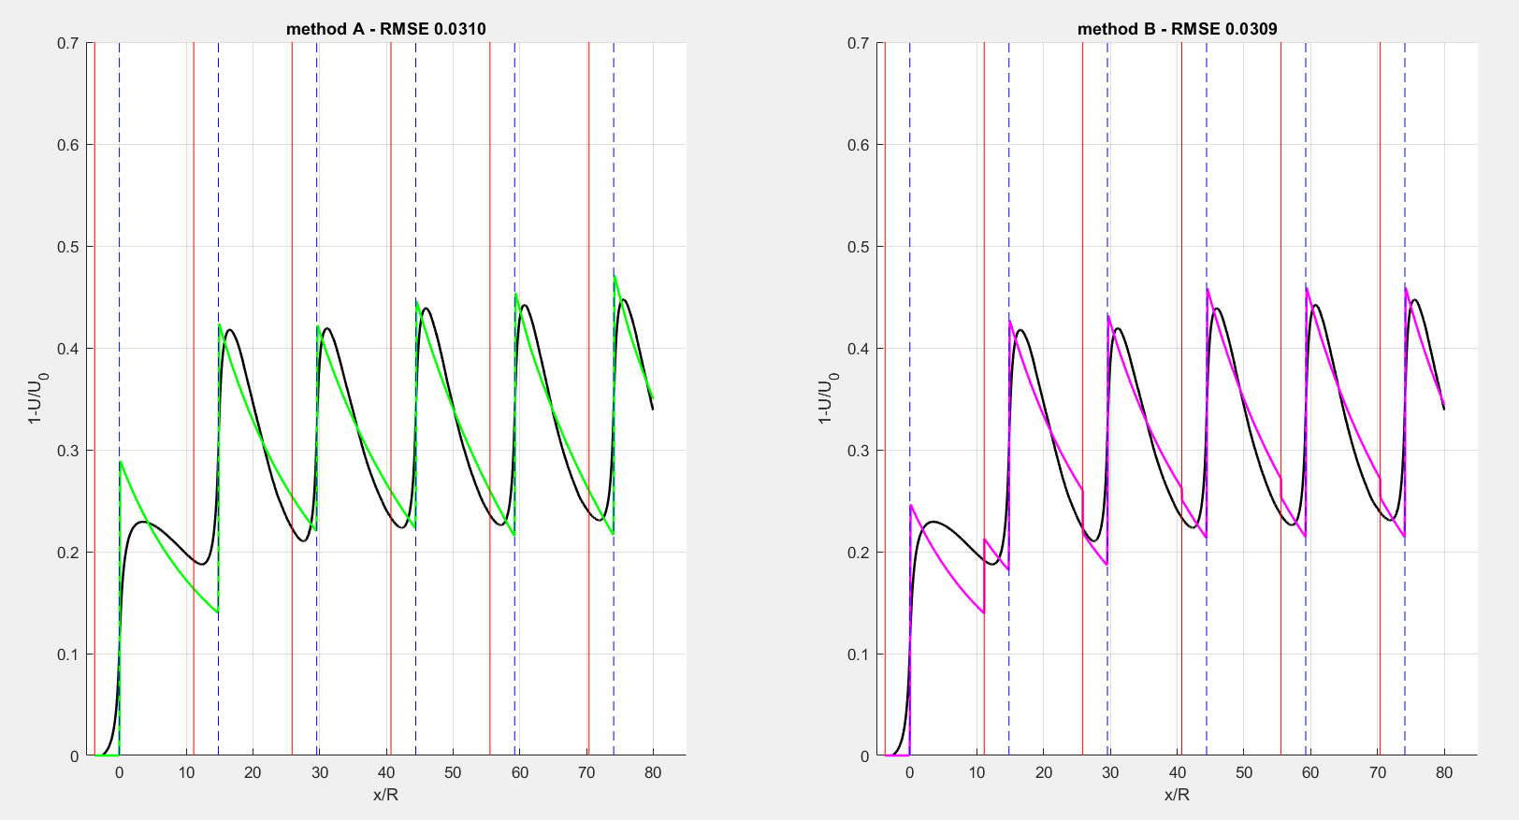
Optimization methods – Park wake
Short Park wake + extrapolation

Slide 16
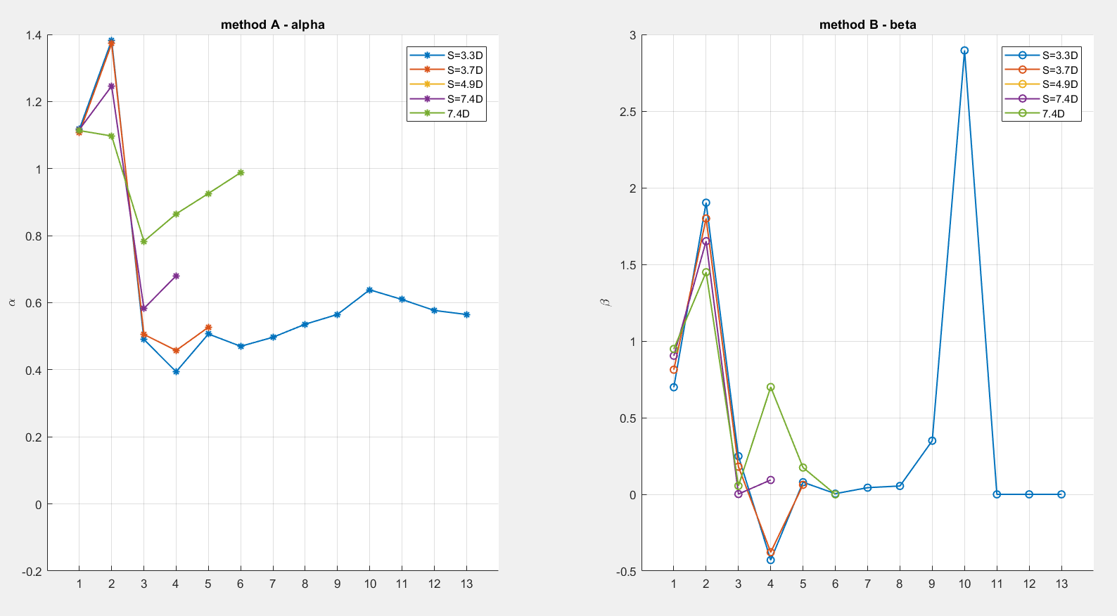
Optimization methods – Park wake
Short Park wake + extrapolation

Slide 17
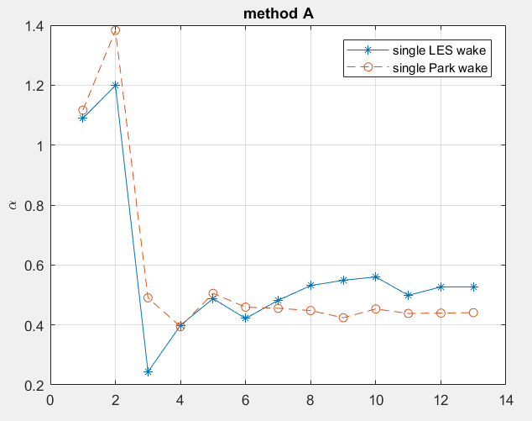
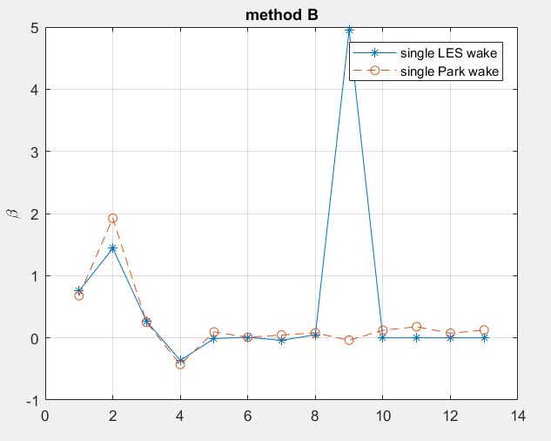
Optimization methods – LES vs. Park wake

Slide 18
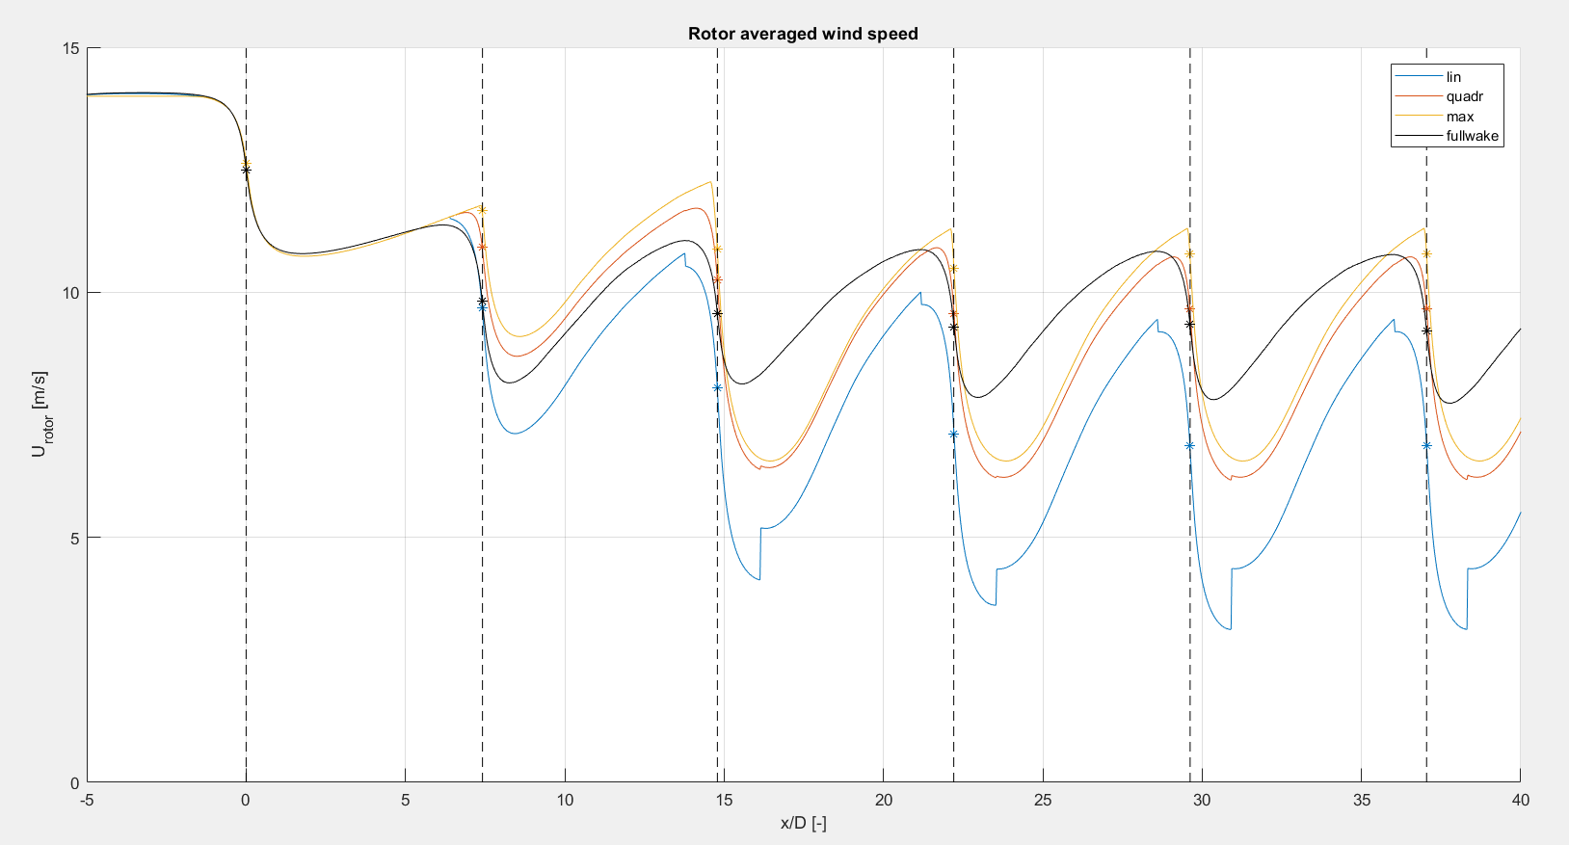
LES superposition
Wake 1: 14m/s, TI 3,5%
Wake 2: 11,2 m/s, TI 8%
Wake 3-6: 8,6 m/s TI 3,5%

Slide 19
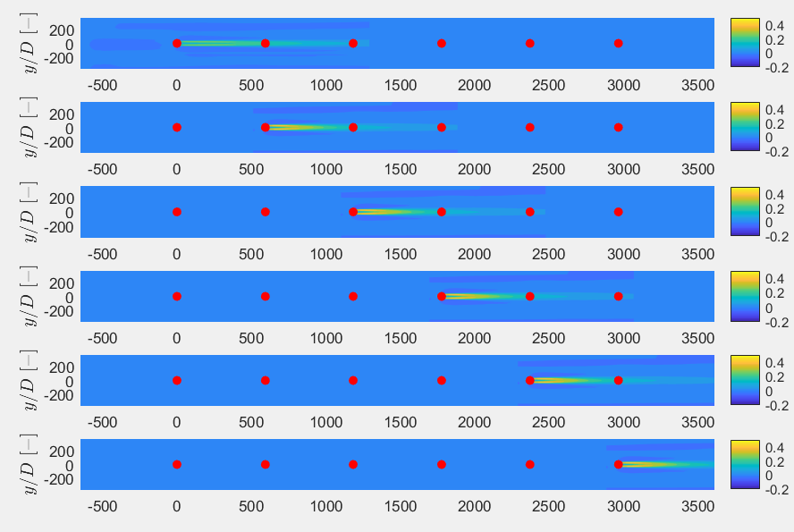
LES superposition
Wake 1: 14m/s, TI 3,5%
Wake 2: 11,2 m/s, TI 8%
Wake 3-6: 8,6 m/s TI 3,5%

Slide 20
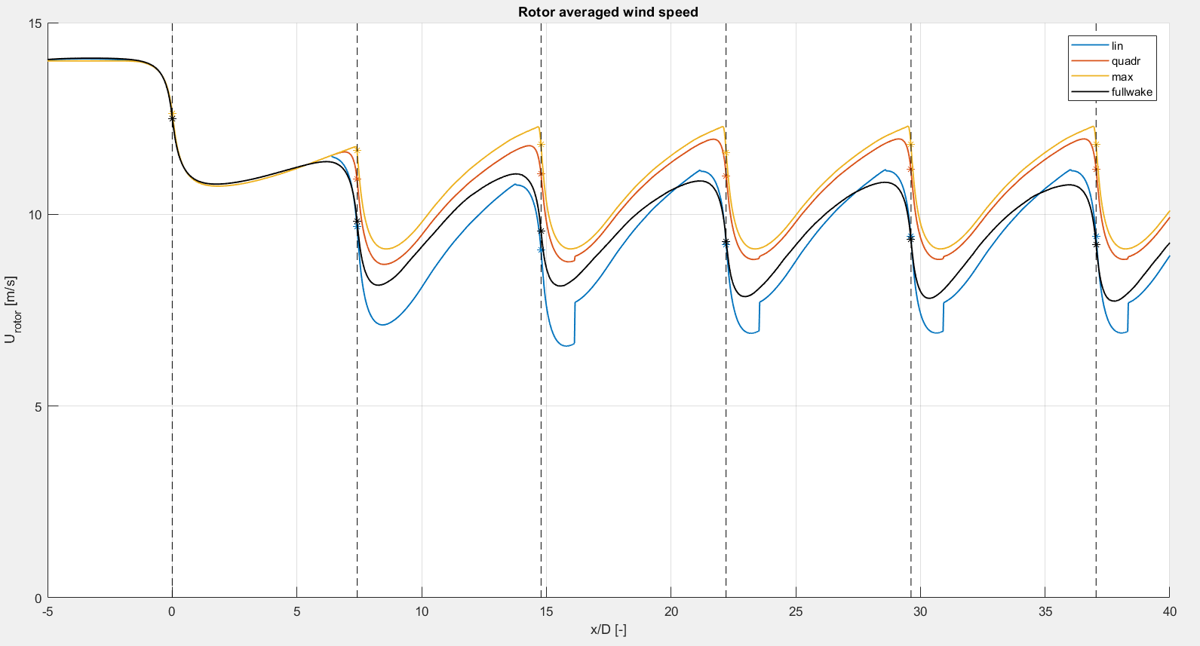
LES superposition
Wake 1: 14m/s, TI 3,5%
Wake 2: 11,2 m/s, TI 8%
Wake 3-6: 11,2 m/s TI 8%

Slide 21
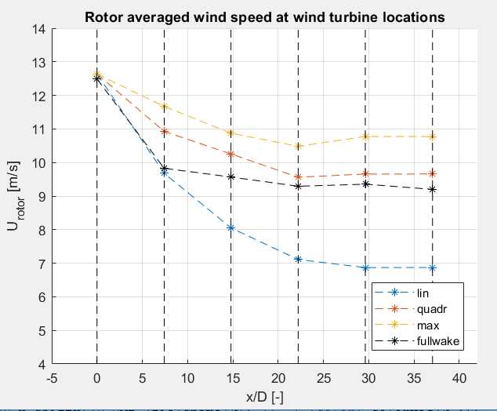
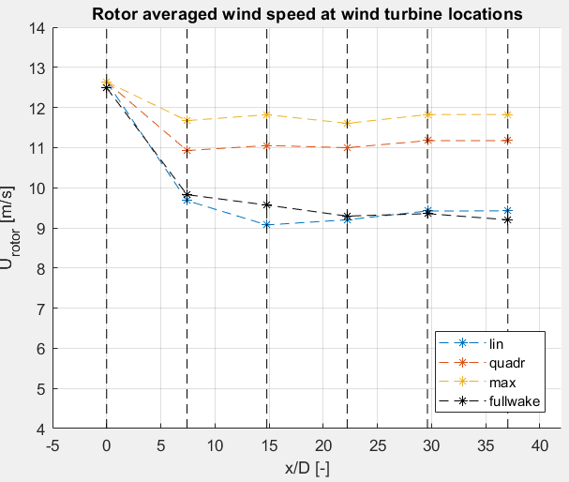
LES superposition
Wake 1: 14m/s, TI 3,5%
Wake 2: 11,2 m/s, TI 8%
Wake 3-6: 8,6 m/s TI 3,5%
Wake 1: 14m/s, TI 3,5%
Wake 2: 11,2 m/s, TI 8%
Wake 3-6: 11,2 m/s TI 8%

Slide 22
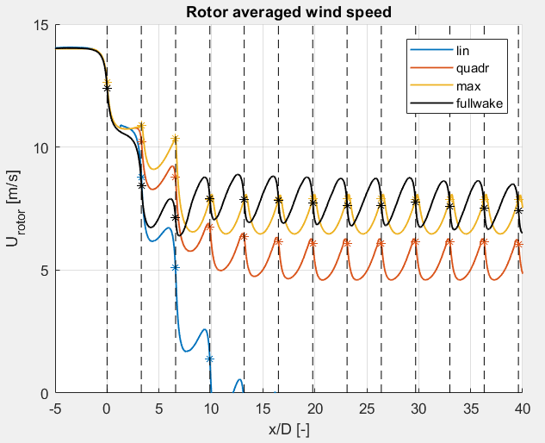
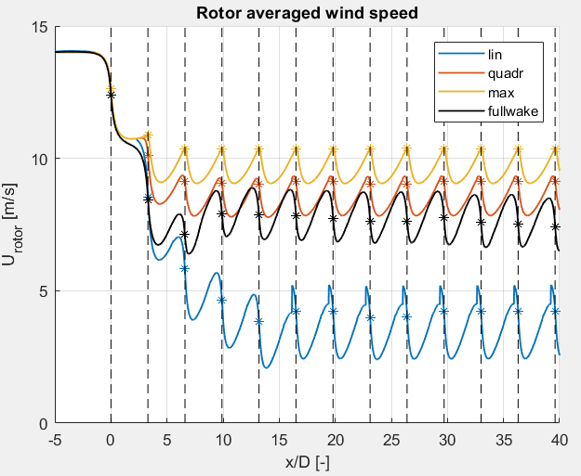
LES superposition
Wake 1: 14m/s, TI 3,5%
Wake 2: 11,2 m/s, TI 8%
Wake 3-6: 8,6 m/s TI 3,5%
Wake 1: 14m/s, TI 3,5%
Wake 2: 11,2 m/s, TI 8%
Wake 3-6: 11,2 m/s TI 8%

Slide 23
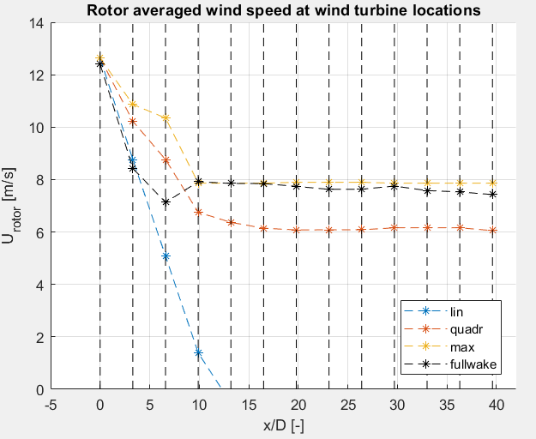
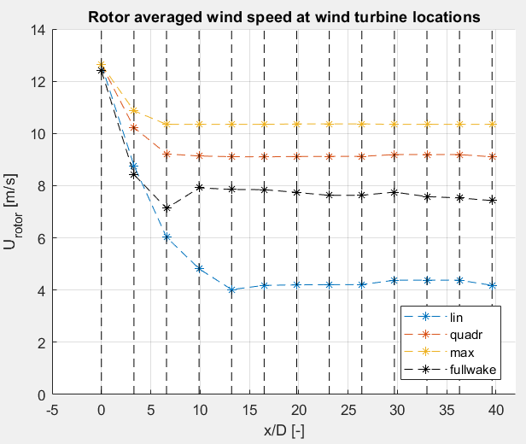
LES superposition
Wake 1: 14m/s, TI 3,5%
Wake 2: 11,2 m/s, TI 8%
Wake 3-13: 8,6 m/s TI 3,5%
Wake 1: 14m/s, TI 3,5%
Wake 2: 11,2 m/s, TI 8%
Wake 3-13: 11,2 m/s TI 8%

Slide 24
Practical
Final draft
Sketches
List of symbols and abbreviations
Acknowledgement & Abstract
Thesis defence?

